Slide 1
BLOCKCHAIN MANAGED SOCIAL DISTANCING
DETECTOR

Slide 2
Current contact tracing solutions lack consistency, privacy and dependable data
1

Slide 3
Our Solution
A data integrity validation tool to enable the use of AI for physical distancing detection by mitigating concerns with privacy and tampering through a hybrid on and off-chain system.

Slide 4
Benefits of Using Blockchain
Preserves data integrity
Removes risk of data tampering or corruption
Transparency on what is happening
These benefits are essential to consistently enforcing social-distancing guidelines and slowing the spread of COVID-19

Slide 5
HOW IT WORKS
Build Computer Vision Detector
Incorporate Blockchain Storage
Deploy and Monitor Social Distancing
Implement a YOLO detection model to accurately and consistently identify individuals not following social-distancing guidelines
The use of blockchain ledgers and smart contracts preserve the integrity of the data and allows for easy analysis of social distancing practices throughout different locations
Deploying the detection model to video feed of webcams and record social distancing. The detections made by the model are flowing through the blockchain and good/bad distancing are recorded

Slide 6
Details of Hash Process
Event ID, location, timestamp, and number of violations are combined and hashed with SHA256 and stored On-Chain through a smart contract.
Hashes are easily computable given event data, but hashes are not easily reversible. This mitigates privacy concerns about distancing data and ensures integrity.
Data can be easily verifiable by computing and verifying hash with event logistics and ID in Off-Chain database.

Slide 7
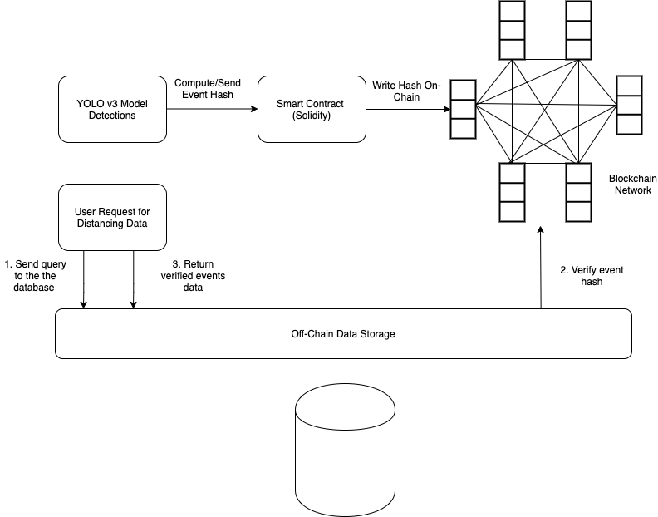
Application Diagram

Slide 8
Business Model
Users use our service to measure how well people in their vicinity are social distancing
Users with video cameras desire a way to monitor how well social distancing measures are being followed
Users analyze the results to figure out if changes are needed to better follow the social distancing measures
Social distancing measures will have a quantitative way to ensure they are being followed

Slide 9
Business Value
Potential users will be those who would have a desire to monitor how well people under their surveillance are social distancing
Those users will be able to confirm if the social distancing guidelines are being met with the measures they currently have in place

Slide 10
Market Research
Market Size
Beachhead
Market
TAM
Consumers with a video monitored area
100,000 consumers. There are currently 70 million surveillance cameras in the US
Consumers who are looking to monitor how effective their social distancing precautions are

Slide 11
Market Plan
Advertisement
Social media ads
Market Penetration Strategy
Free trial of service
Channels of Distribution
Download through website
Retention
Continual improvement of features

Slide 12
Thank you

Slide 13
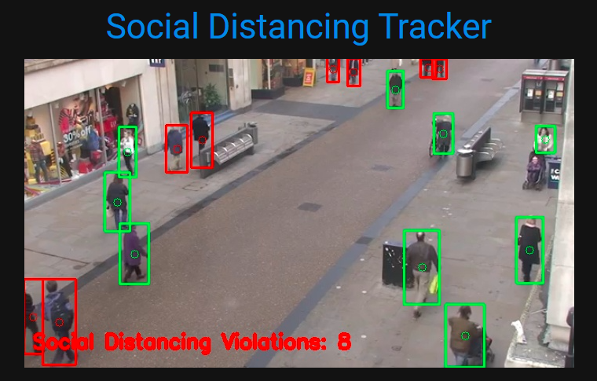
Place your screenshot here
Main View
Shows real time if people on camera are following social distancing measures

